Slide 1
SUMO Autonomous Simulator
By: Jae Hyeok Hyun, Ryang Jin Lee

Slide 2
Objective
Simulate the real life traffic congestion that occurs due to traffic light inefficiency.
Count the number of vehicles that comes to the specified intersection and record the time.
With this data, simulate real life traffic congestion into SUMO by using the data.
Make changes to the traffic light behavior to assess the behavior of the traffic congestion.
Derive a best traffic light algorithm that lessens the real life traffic congestion problem.

Slide 3
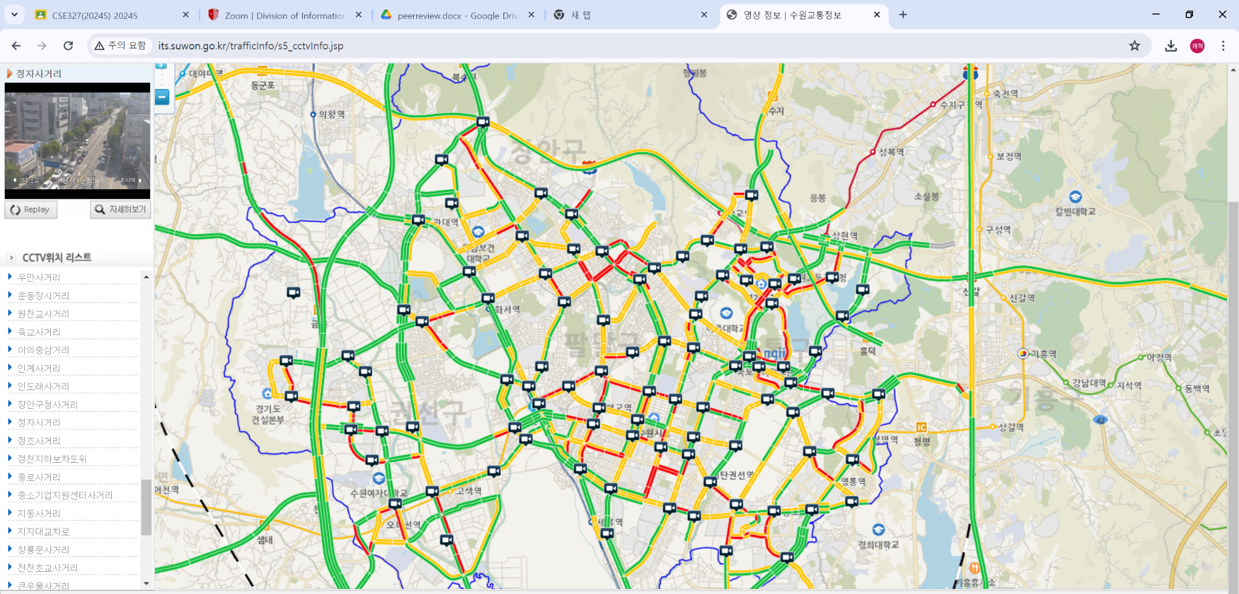

Slide 4
Computer Vision
Yolo v9
Coco Dataset
Classification of Passenger Cars, Trucks, Buses, and Motorcycles
Input: A Video Footage (CCTV) of a traffic congestion
Output: Classification Footage / Record of vehicles, direction, and time marker of the vehicles.

Slide 5
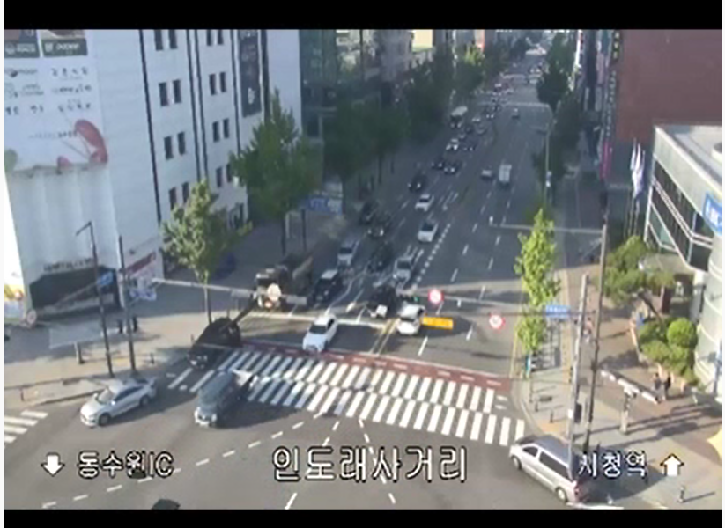
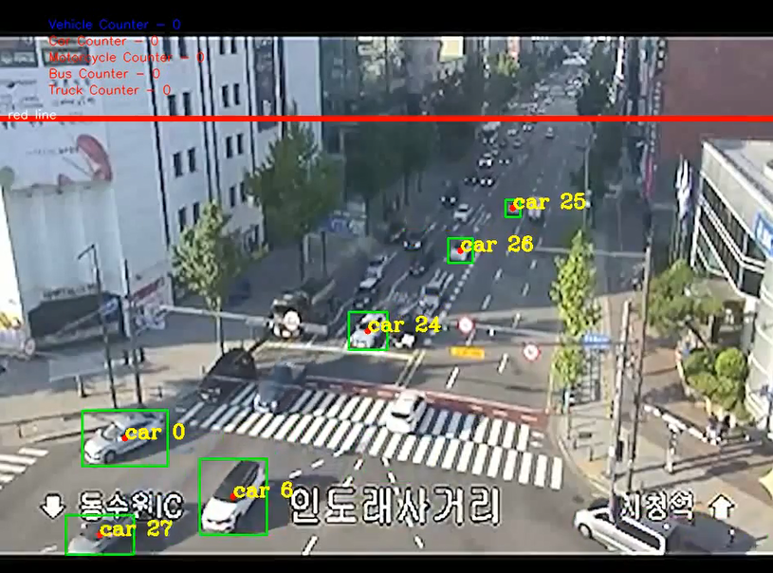
So how does it work?
- Takes a Footage and use Yolov9 classification to detect the following: Car, Trucks, Buses, Motorcycles.
- Draw a red line that indicates the counting mechanism for the vehicles.

Slide 6
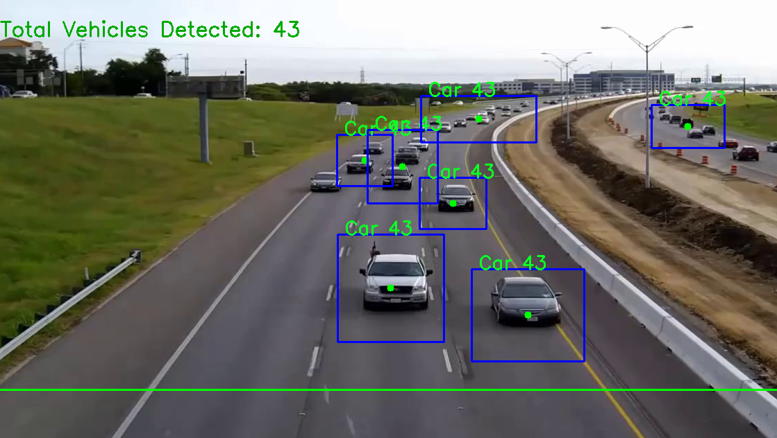
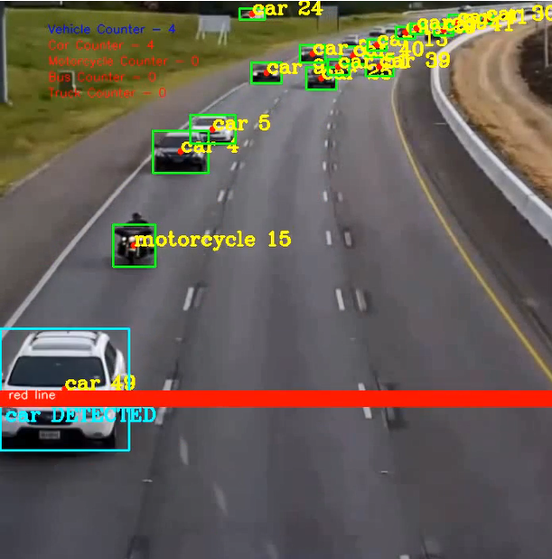
Methodology
- Draw Rectangles and a center circle for each detected node within each frame of the video.
- When the circle is detected by intersecting with the line, indicate that the car has been detected.
-Since each vehicle has a unique numbered id that do not overlap, a vehicle that has been classified wont be detected more than once if the id of the vehicle exists within the already detected data.
- To prevent loss of counting due to the frame rate, increase the offset (Thickness) of the detecting line to ensure maximum intersection with the vehicles.

Slide 7
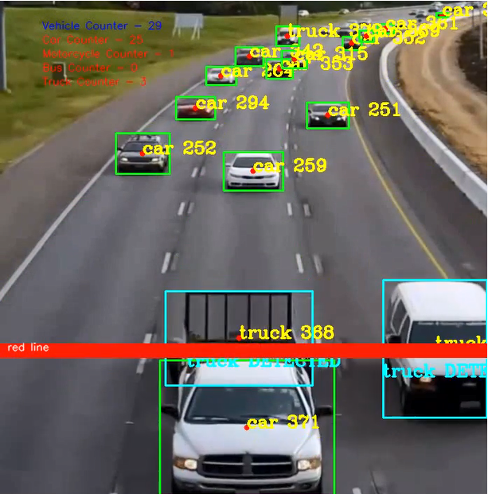
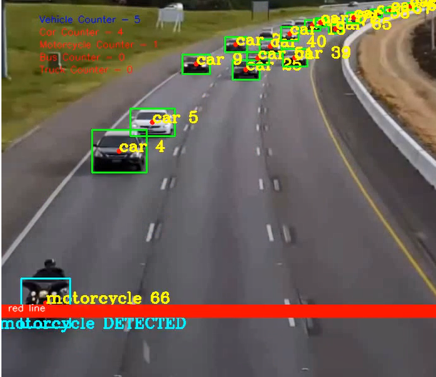
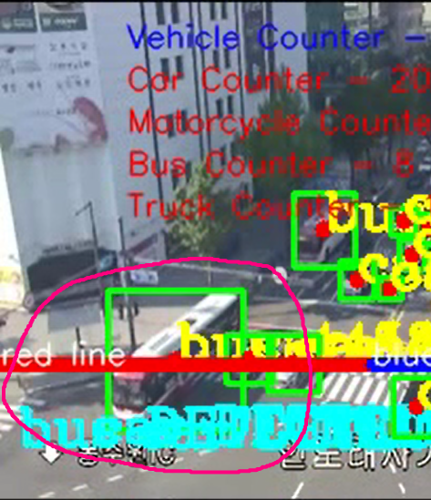
Methodology
- Ensure that the detection process is catching different classifications: Cars, Trucks, Buses, Motorcycles.
- Ensure that the sum of each type of vehicles equals to the amount of total vehicles actually detected during the video.

Slide 8
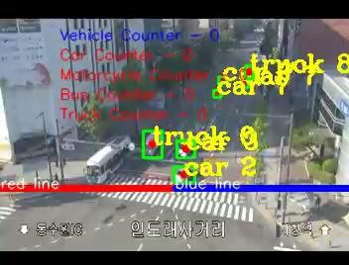

Slide 9
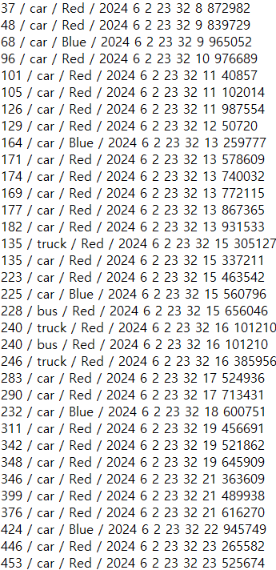
Output after Classification
Achievements:
ID of the unique car that has been counted
Vehicle Type
Direction the Vehicle was Detected at
Exact Time Frame of the interval of cars that has been detected by the line.
Limitations:
If a vehicle changes its classified class when intersecting with the line, they are recorded twice with the similar classification.
Since the CCTV footage was very small and low in resolution, the classification might derive to different results for same vehicle.

Slide 10
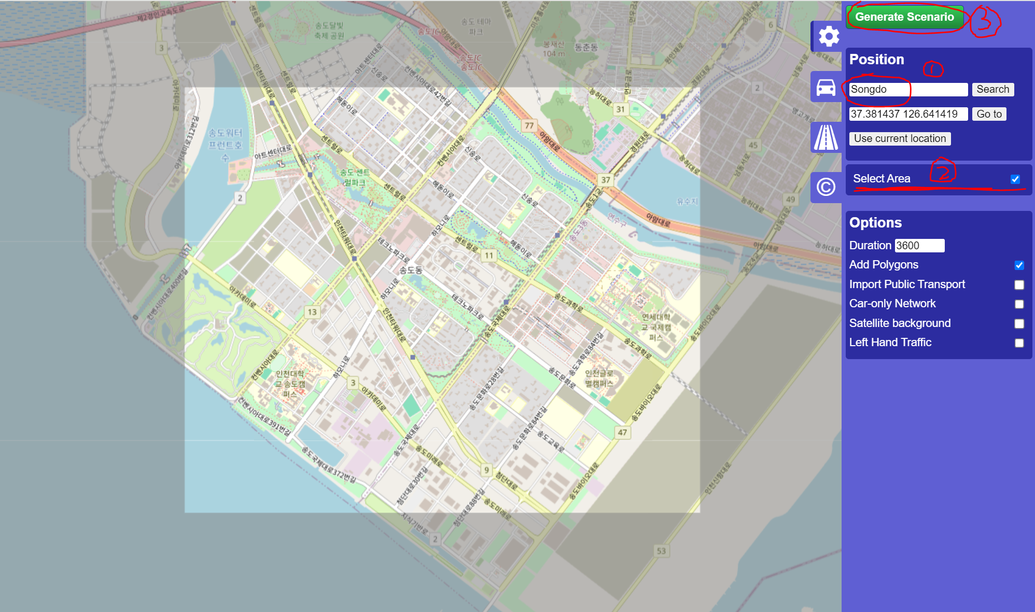

Slide 11
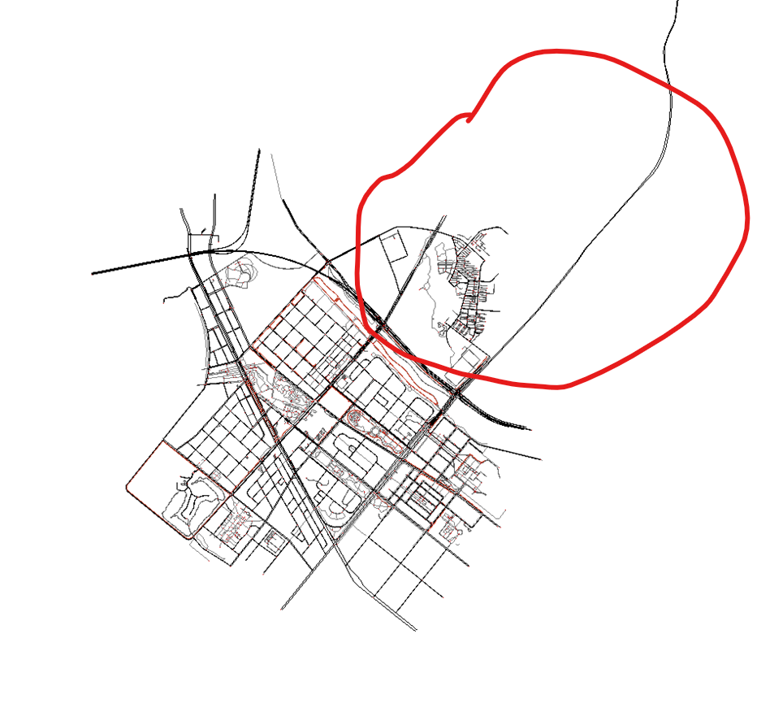
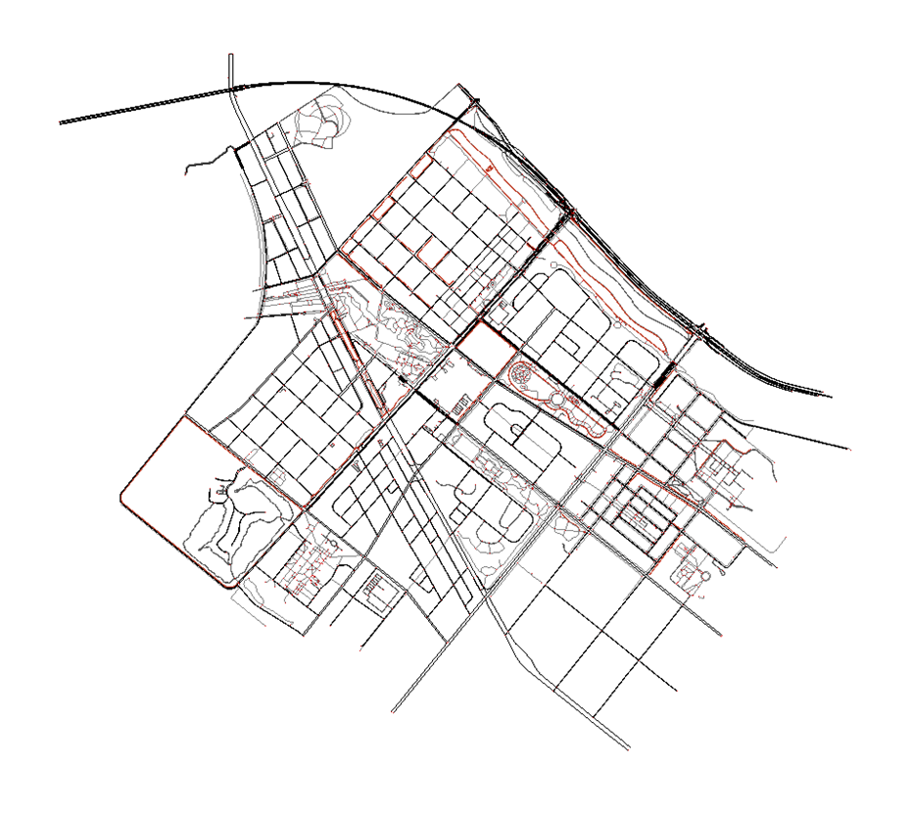

Slide 12
Vehicle Congestion
-Simulate the real life busy traffic hours in songdo and how the routes change accordingly to the changes in traffic.
-Generate Vehicles in certain lanes to a desired destination in a specific timeframe.
-Observe the changes within the routes of our model car due to congestion of vehicles.
-Train/Test the behavior of our model car to seek best route from start to destination.
-Ex. Simulate Crazy Drivers as vehicles with departLane behavior = Random with High Speed

Slide 13
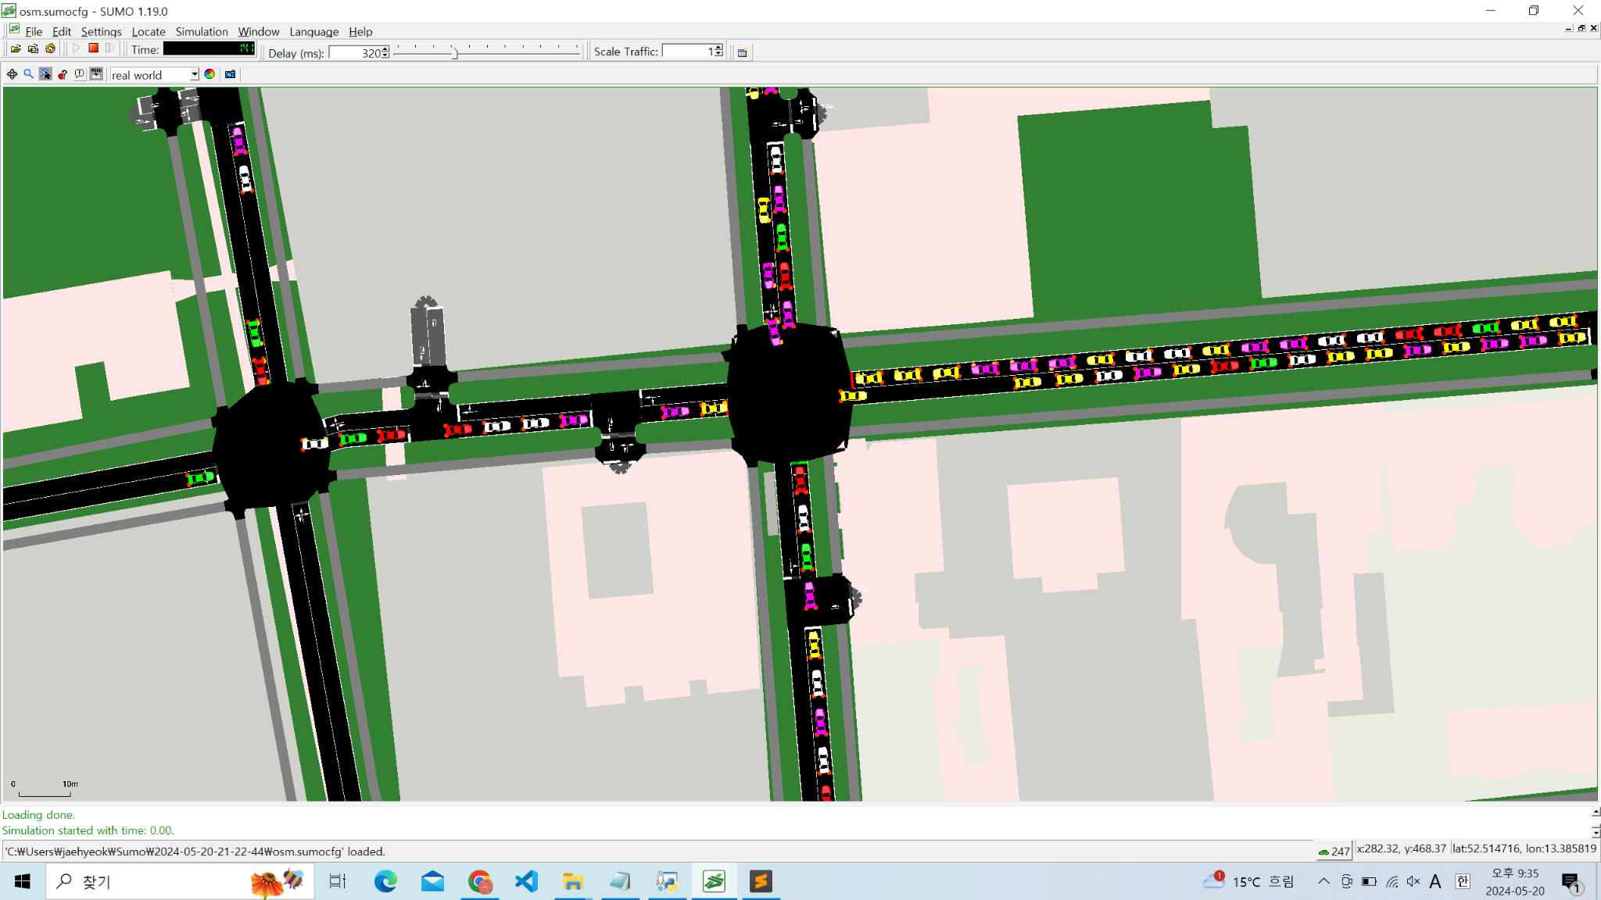
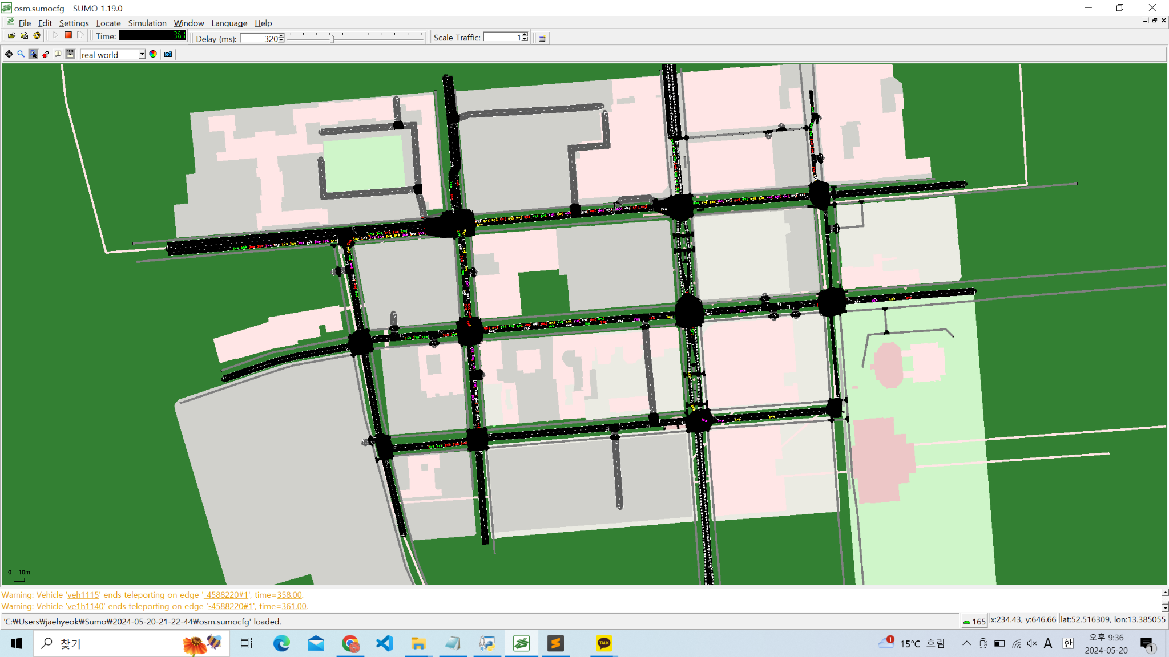

Slide 14
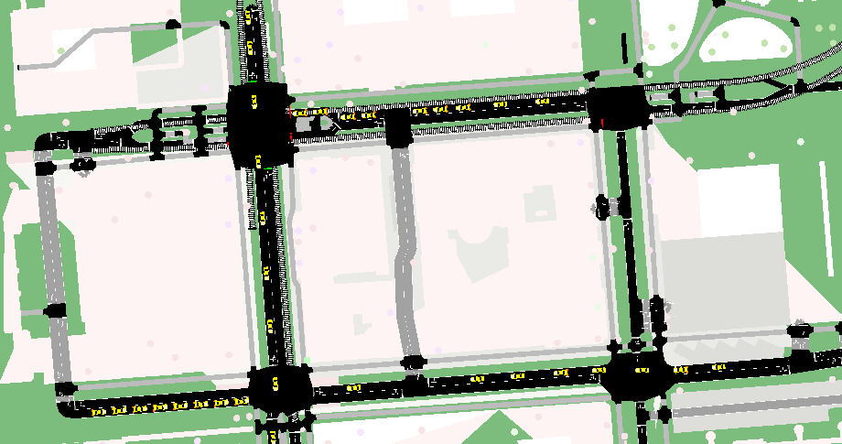

Slide 15
Surrounding Environment Manipulation
-Simulate the real life scenarios such as walking pedestrians, bicycle riders, buses, etc.
-Generate nodes such as pedestrians to simulate changes within the route of the model car.
-Observe the changes within the routes of our model car due to the changes within the surrounding environment.
-Train/Test the behavior of our model car to seek best route from start to destination.

Slide 16
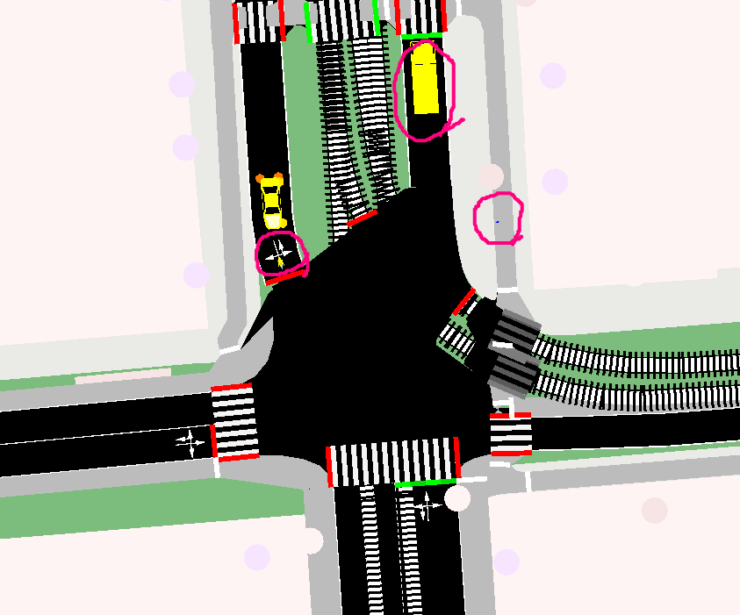
-Instances of Surrounding Environment
Pedestrians
Passenger Vehicles
Buses
Motorcycles
Trucks
Bicycles
Trams
Urban Trains
Trains
Ships

Slide 17
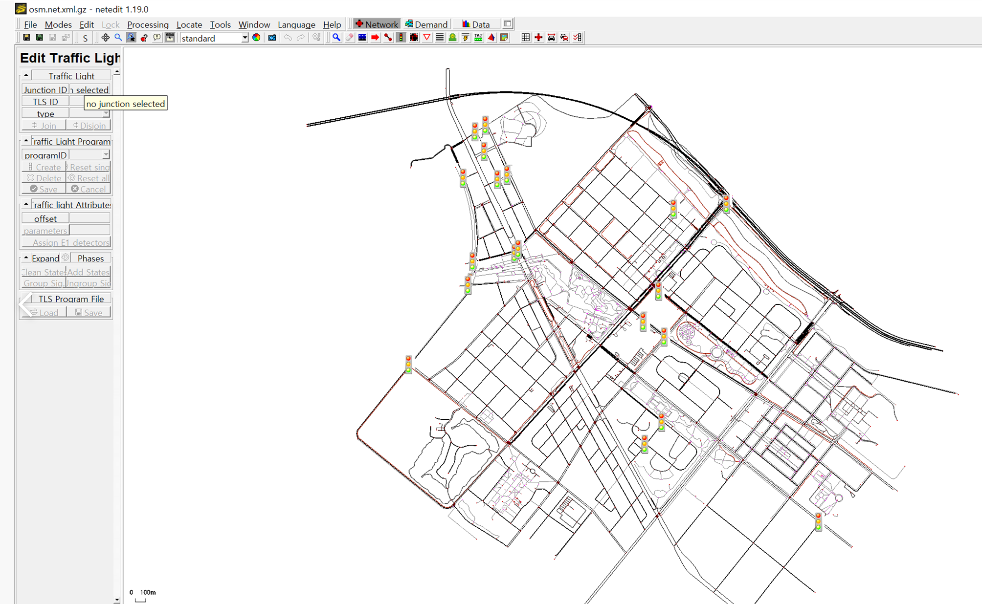
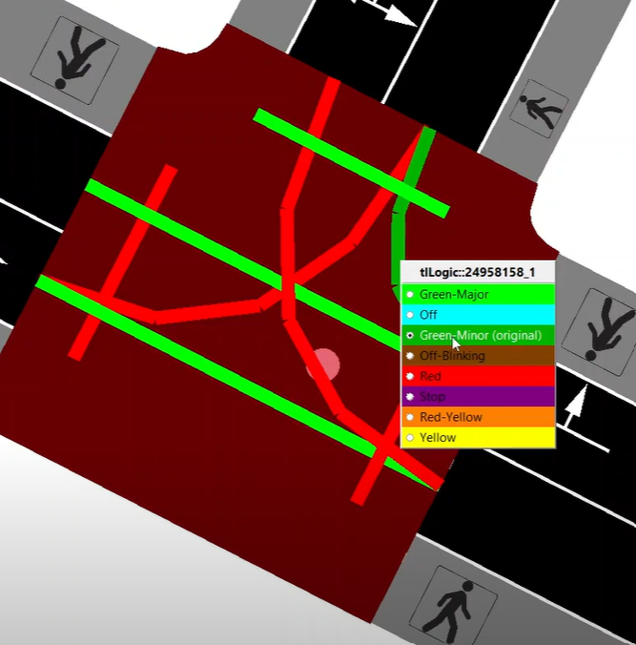
Traffic Lights Manipulation
Can Manually adjust all traffic lights existing on the map

Slide 18
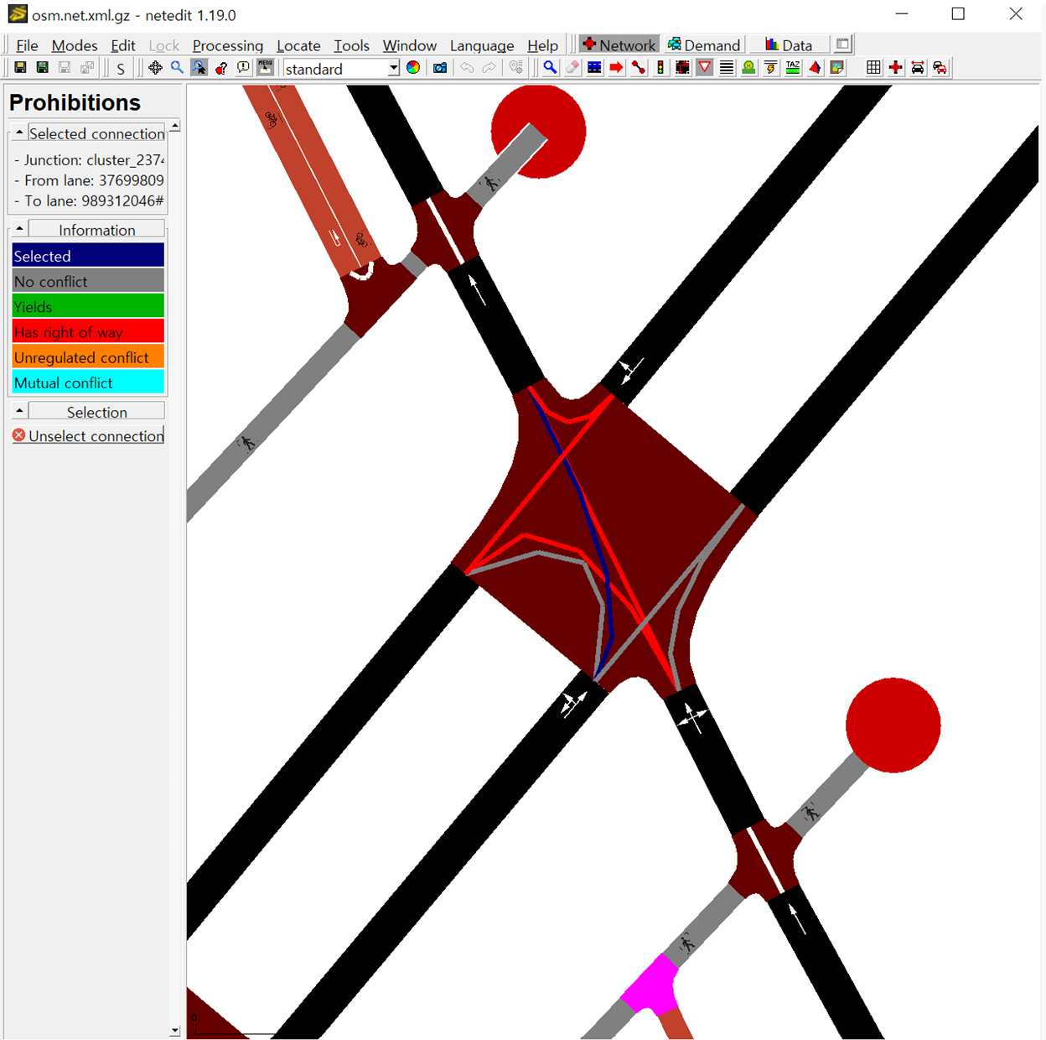
Special Environment Manipulation
Traffic congestion
Accident
Ambulance
We will handle those cases by setting prohibitions.
And observe results accordingly

Slide 19
What will we assess?
-We will be assessing the behavior changes within our model car in finding the most efficient route from start to the destination in different features like stated above.
-We will also be simulating traffic constructions as well as blockages to further train the model car in finding an efficient route to the destination.

Slide 20
Generating Vehicles
Generated cars, trucks, and bus by using dataset from Yolo

Slide 21
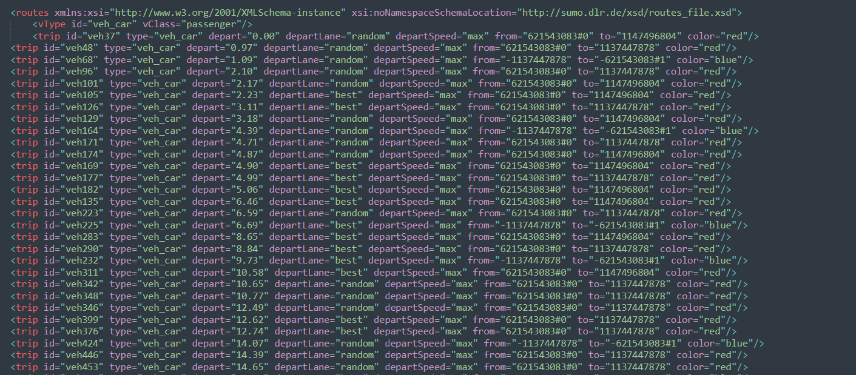
osm.bus.trips
osm.car.trips
osm.truck.trips

Slide 22
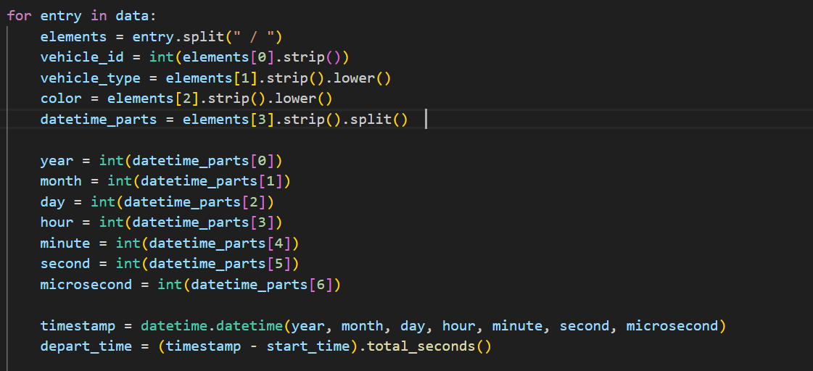
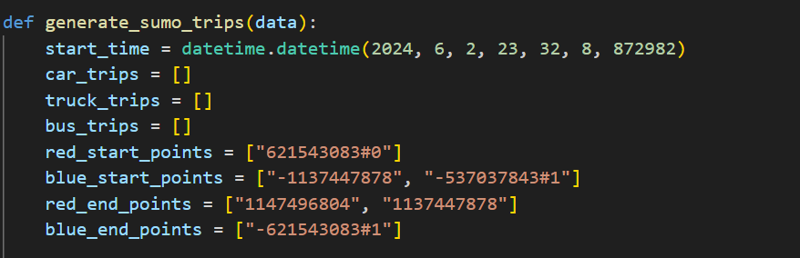
Distinguish Time and Paths

Slide 23
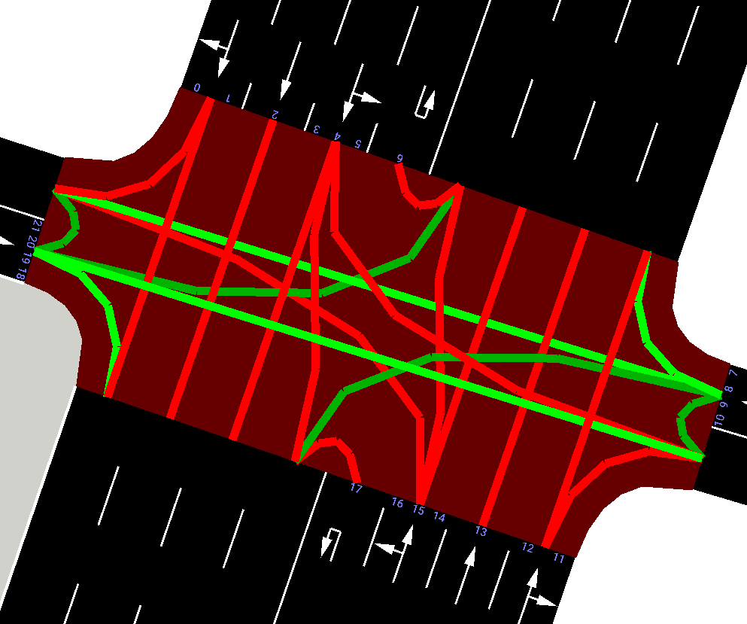
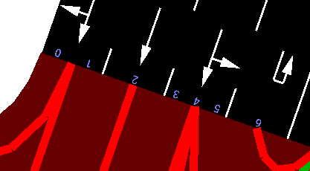
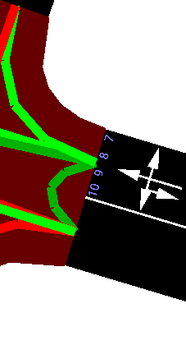
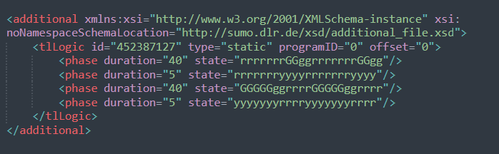
Control Traffic Lights using NetEdit

Slide 24


Slide 25
Case 1
Basic Traffic condition that SUMO provide
Total Time: 4176 sec

Slide 26
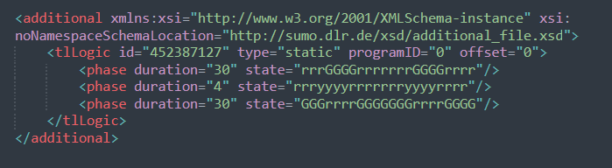
Case 2
Increased duration of green-light for 4-lane way
Total Time: 4148 sec
Time reduced. Why? More car could pass Red and Blue line faster

Slide 27
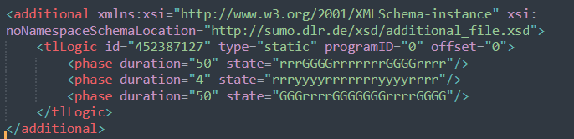
Case 3
Increased duration of green-light for 4-lane way
Total Time: 3994 sec
Time reduced. Why? More and More car could pass Red and Blue line faster

Slide 28
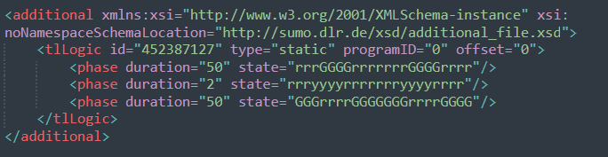
Case 4
Reduced duration of red-light and yellow-light before they change into green-light
Total Time: 4029 sec
Time Increased. Why? Due to the reduced duration of red/yellow light, more cars could pass 4-lane ways faster, but cars which make right turn needed to wait longer

Slide 29
Objective
Simulate the real life traffic congestion that occurs due to traffic light inefficiency.
Count the number of vehicles that comes to the specified intersection and record the time.
With this data, simulate real life traffic congestion into SUMO by using the data.
Make changes to the traffic light behavior to assess the behavior of the traffic congestion.
Derive a best traffic light algorithm that lessens the real life traffic congestion problem.

Slide 30
Thank You :)

